Slide 1
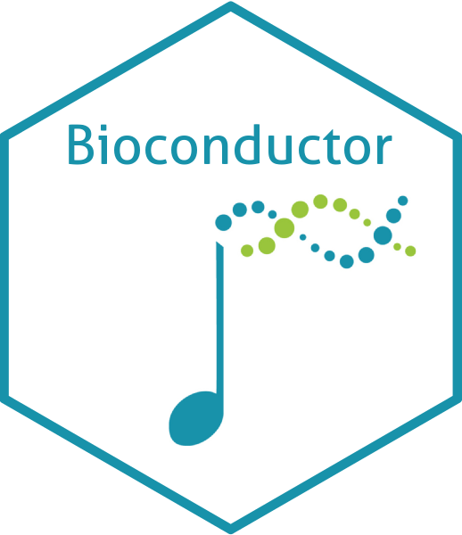
What is Bioconductor ?
Maria Doyle, PhD
PyLadies Dublin
October 18th, 2022
Slides adapted from Aedin Culhane

Slide 2

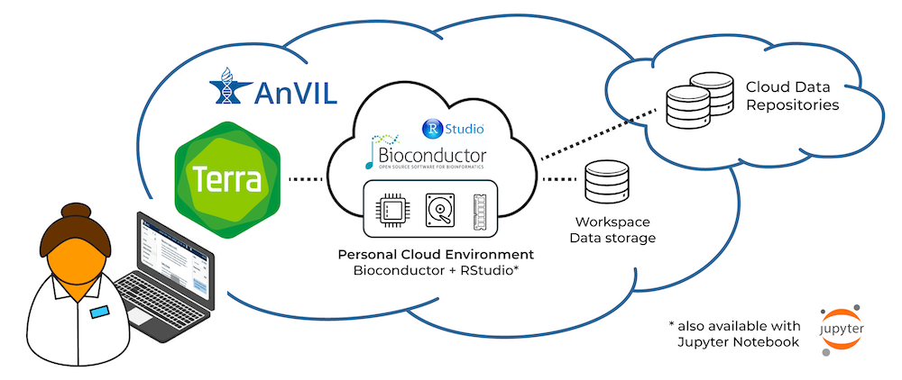

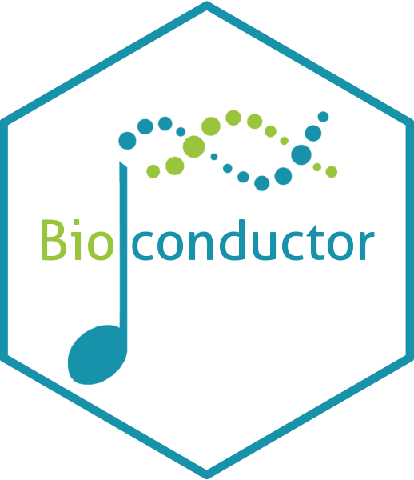

What is Bioconductor ?
Bioinformatics & Genomics Software Repository
Possibly world’s largest bioinformatics project
Free code review
Package system
Daily checks
Continuous integration
Version control
Release & devel branches
Six monthly release cycle
Notes:
(Info on slide) What is Bioconductor - all these things

Slide 3


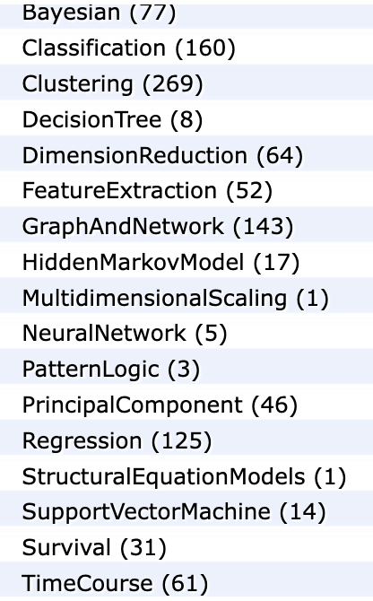
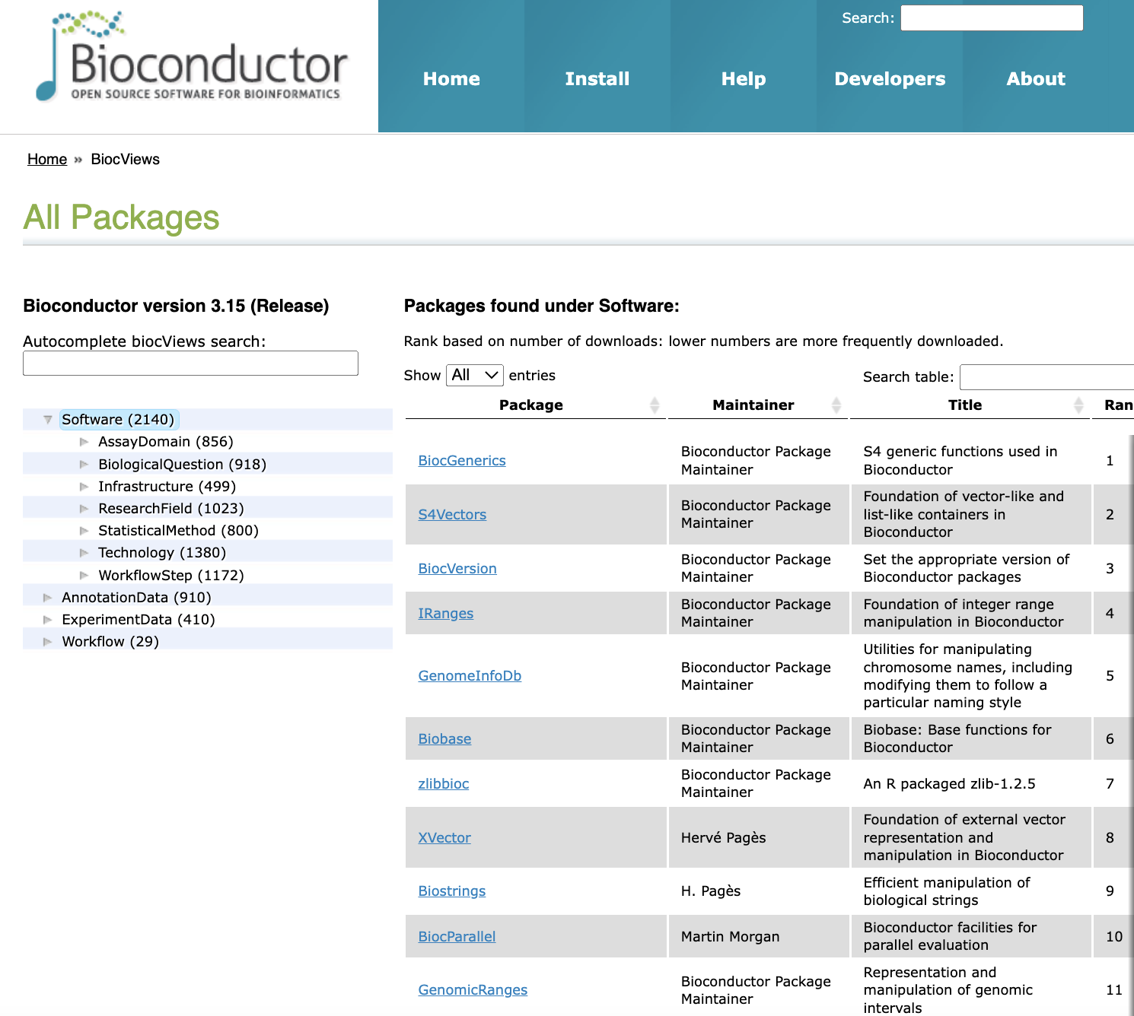
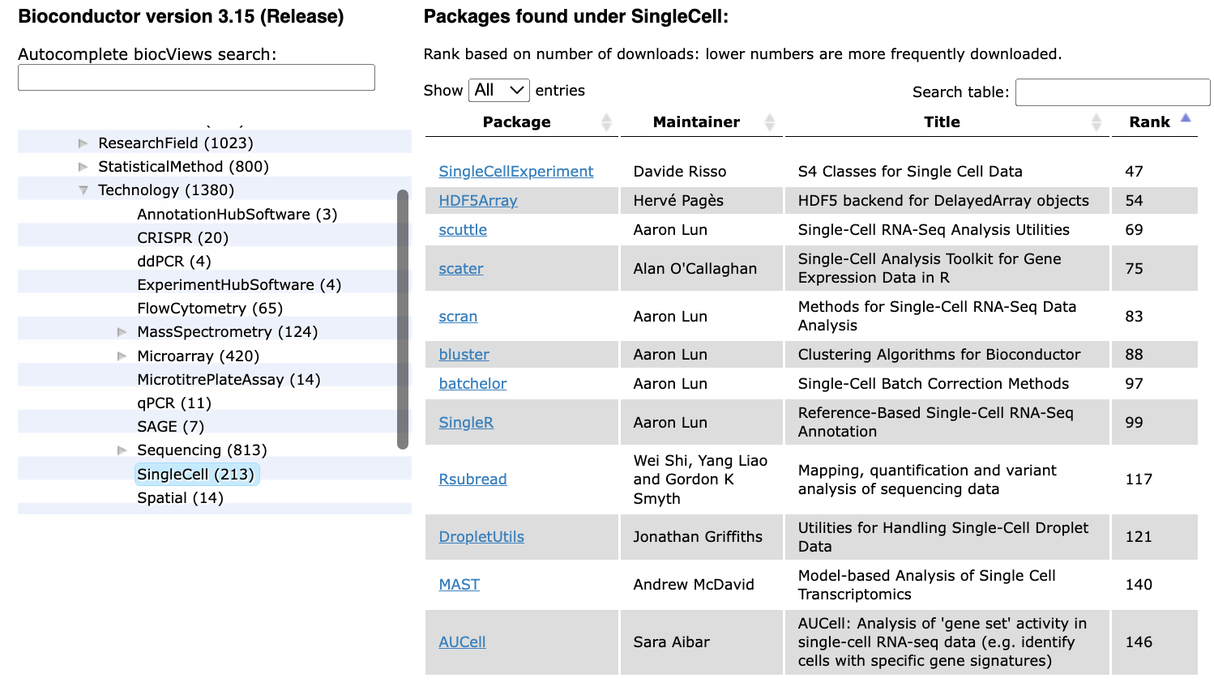
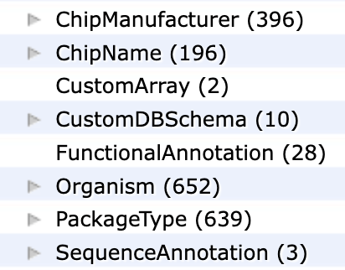
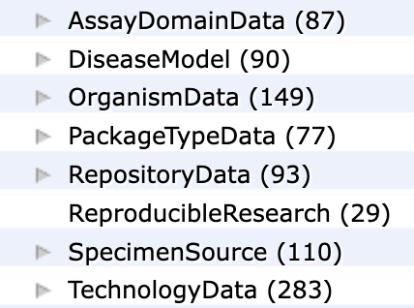
Bioinformatics & Genomics Software
> 2,000 R Packages- world’s largest bioinformatics project
Software (methods) packages
Reticulate
Basilisk
213 R packages for single cell
Annotation packages
Experimental Data packages
Notes:
that include over 2,000 software packages including over 200 packages to analyze single cell genomics data, Annotation packages, Data packages and packages that bridge R and Python.

Slide 4
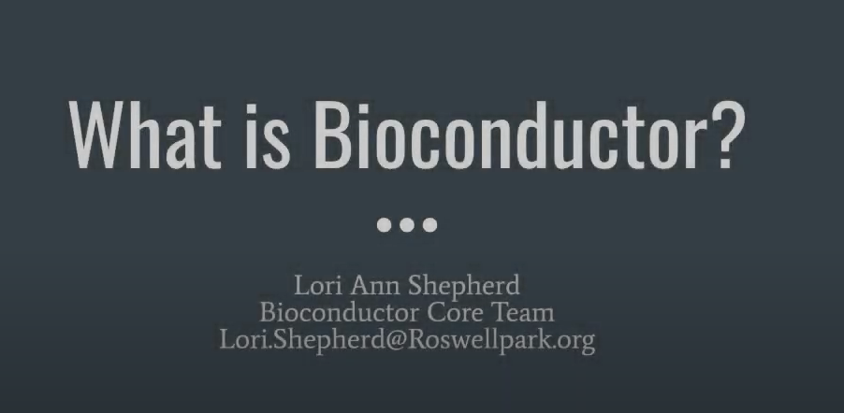

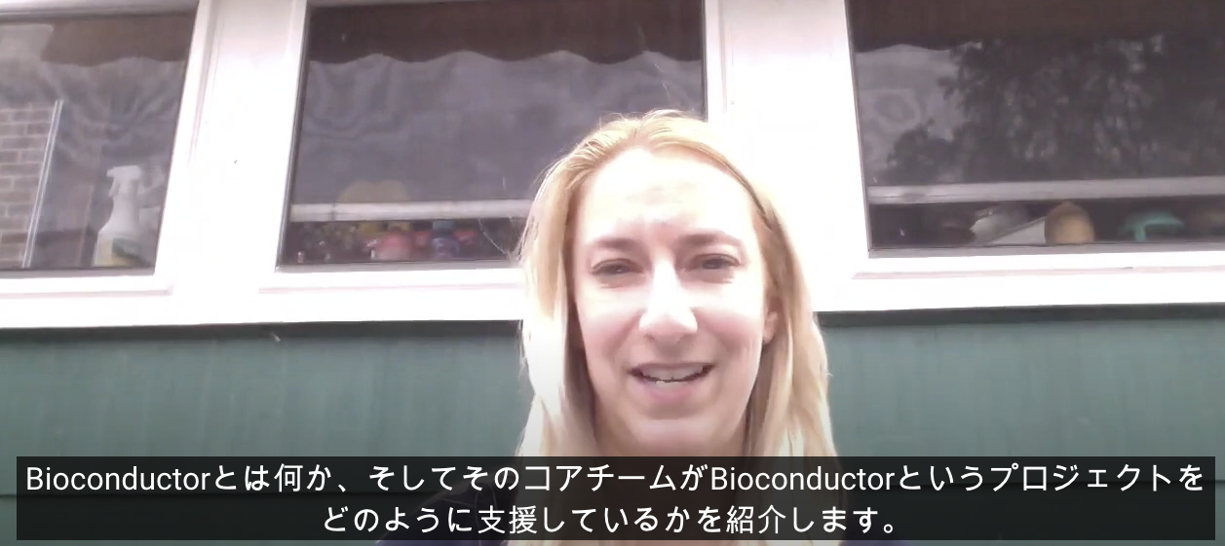
What is Bioconductor ?
https://bit.ly/WhatisBioconductor
Available with Japanese subtitles
Notes:
For more details on What is Bioconductor see this YouTube video by Lori Shepherd from the Bioconductor Asia conference in Japan in December.

Slide 5
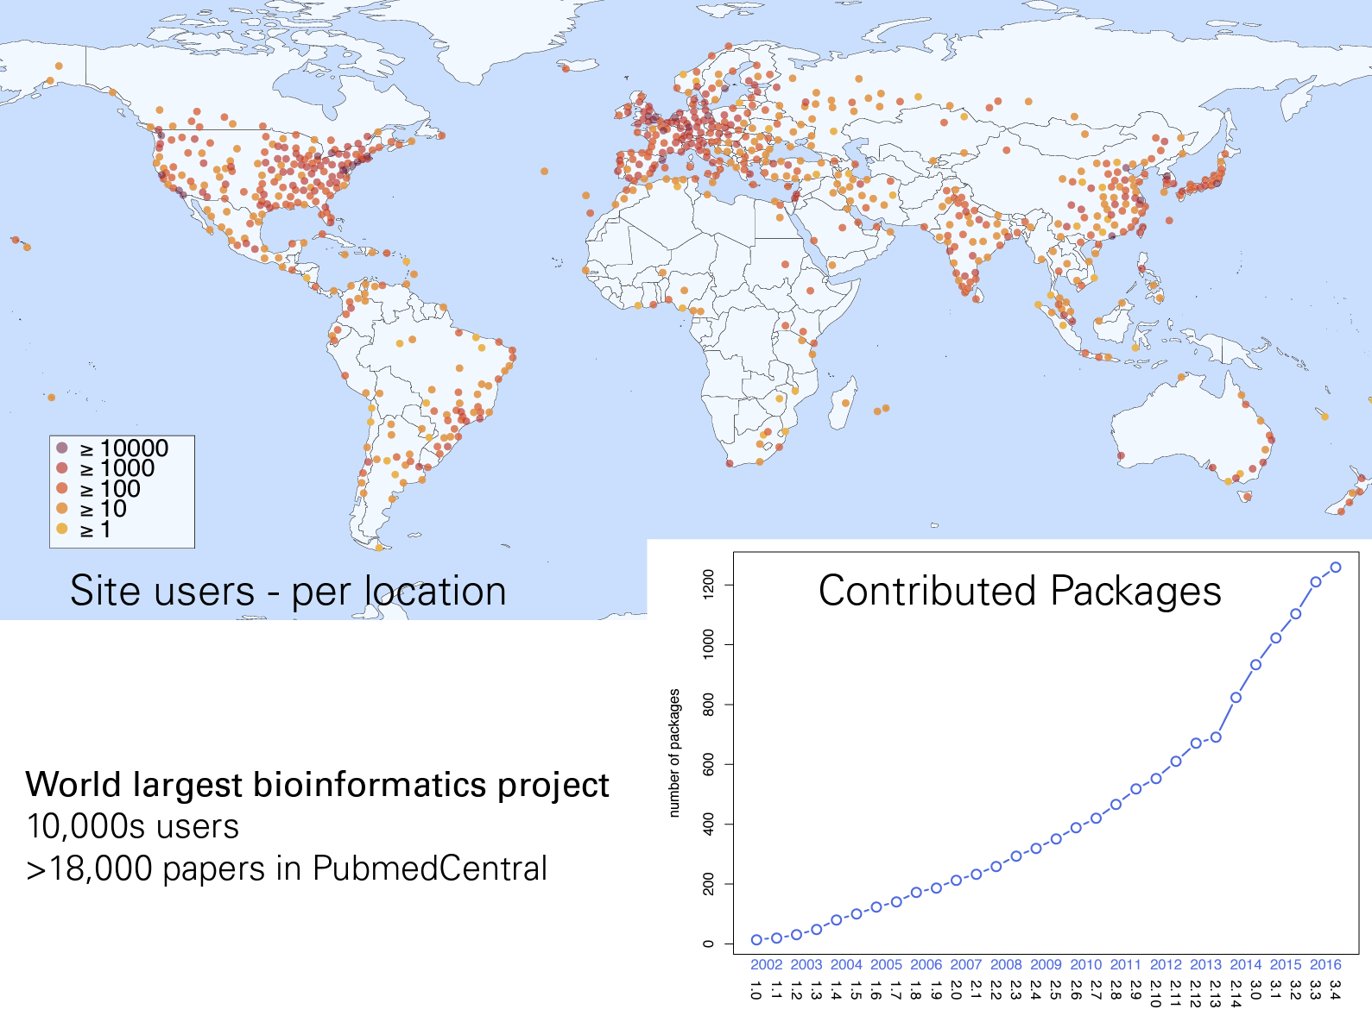
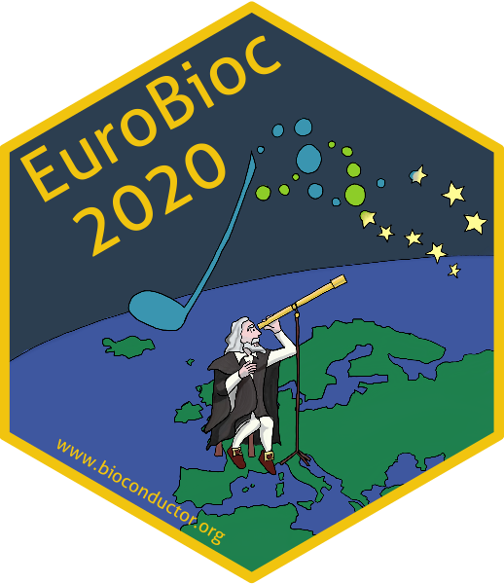
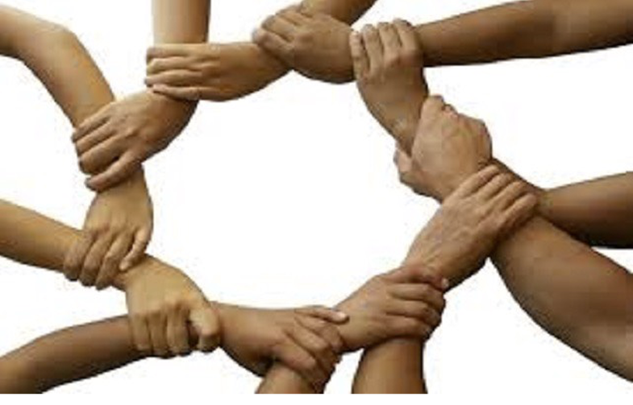
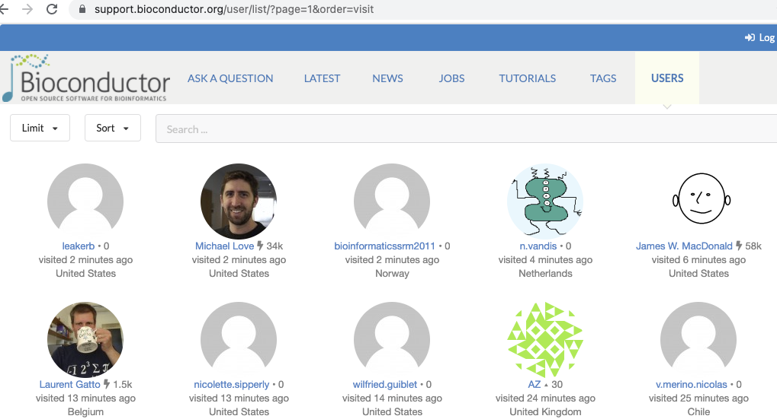
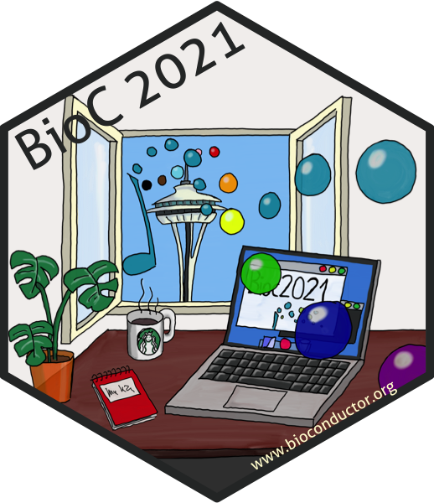
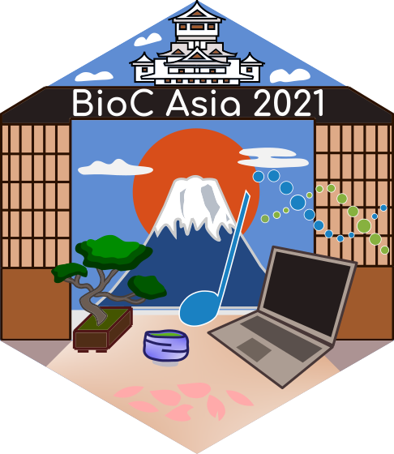
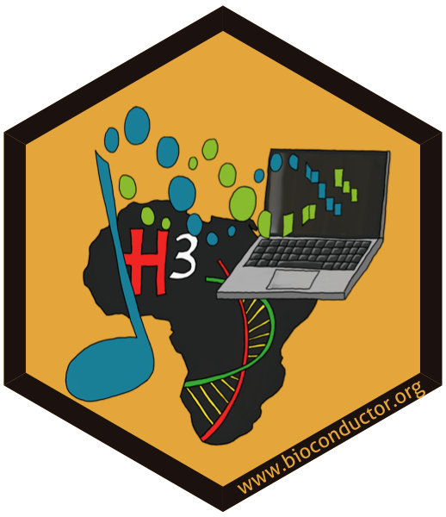
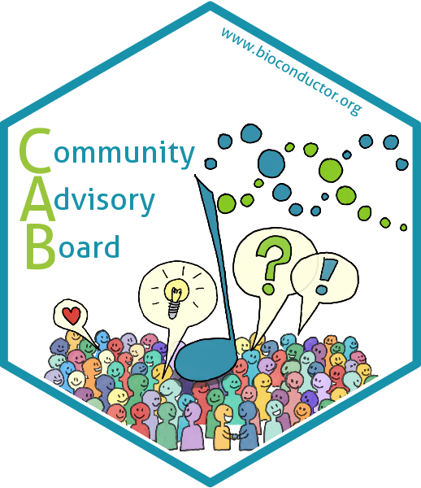
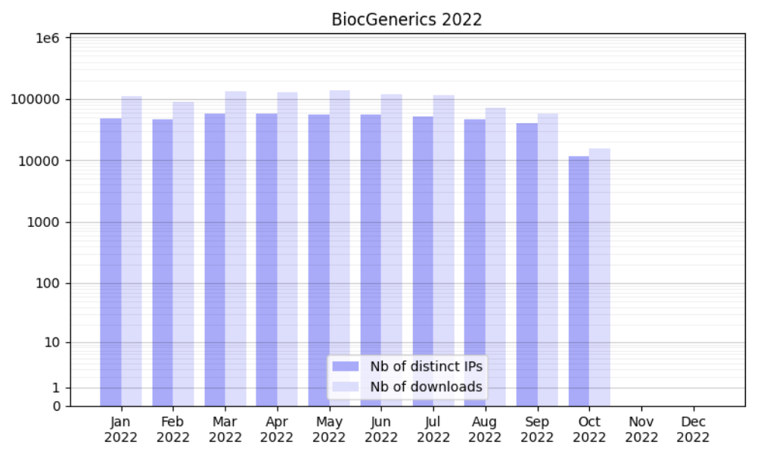

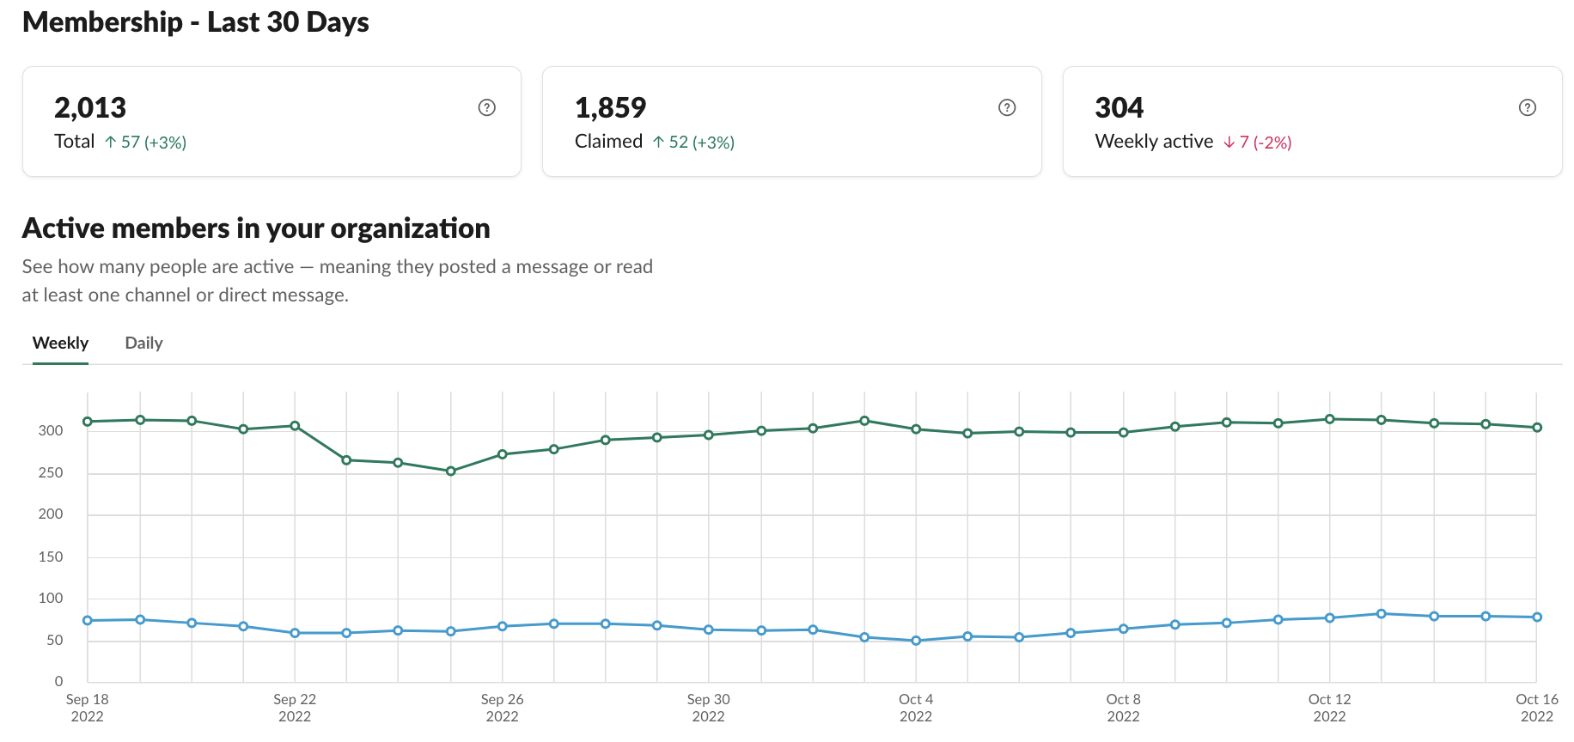
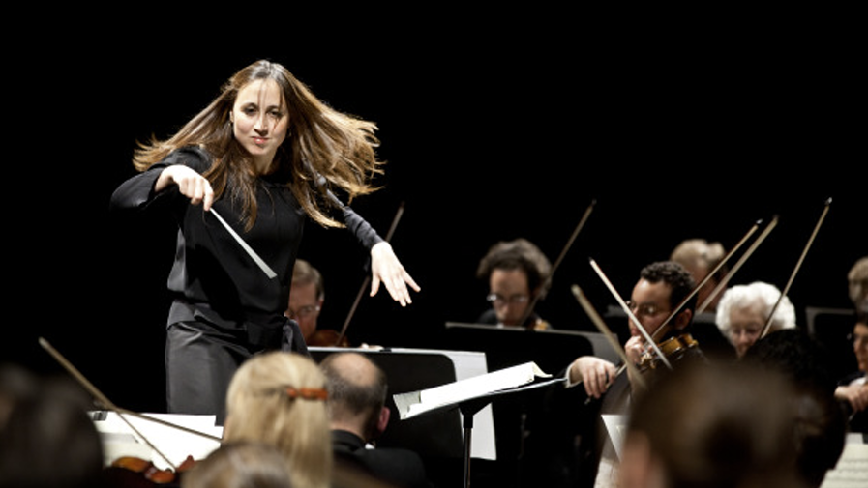

Bioconductor is a worldwide Community
>50,000 users on
https://support.bioconductor.org/
>970,000 distinct downloads in 2022
2,013 members on Slack
>9,000
followers
Notes:
We have a large active global community of users and developers with over 970,000 distinct downloads this year.
Download nos. from: http://bioconductor.org/packages/stats/bioc/BiocGenerics/

Slide 6

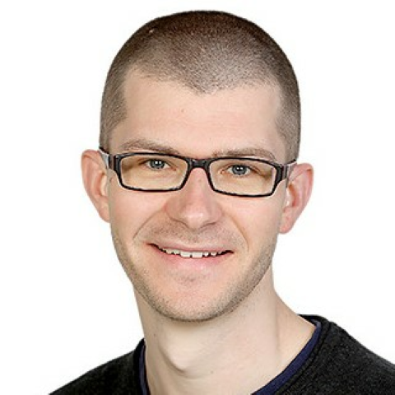
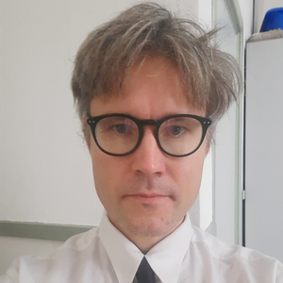
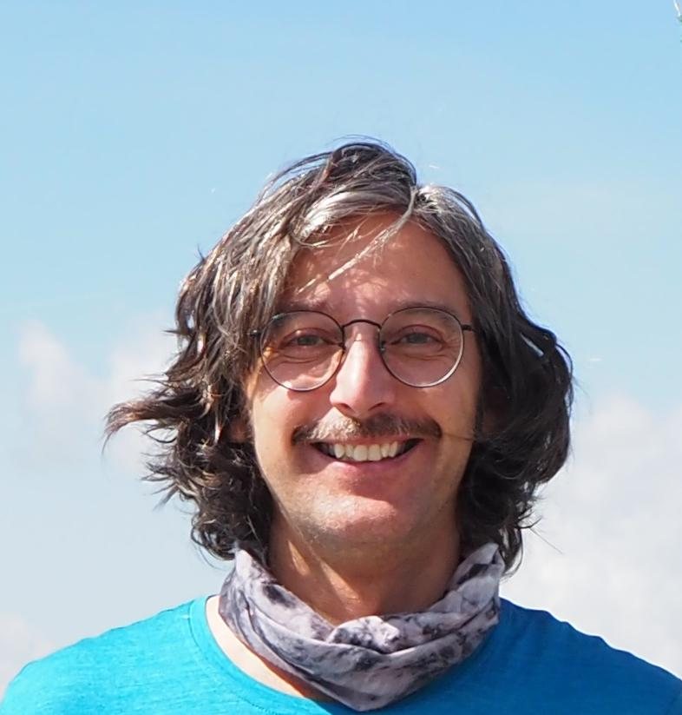
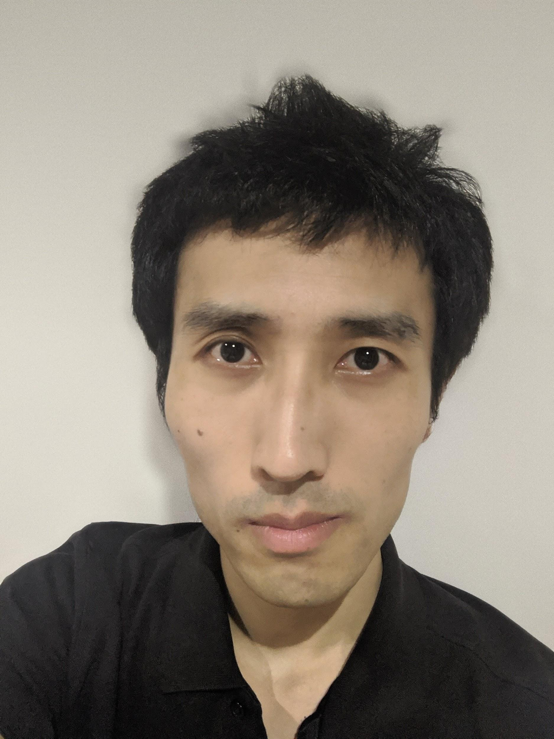

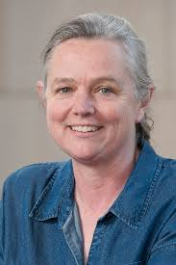

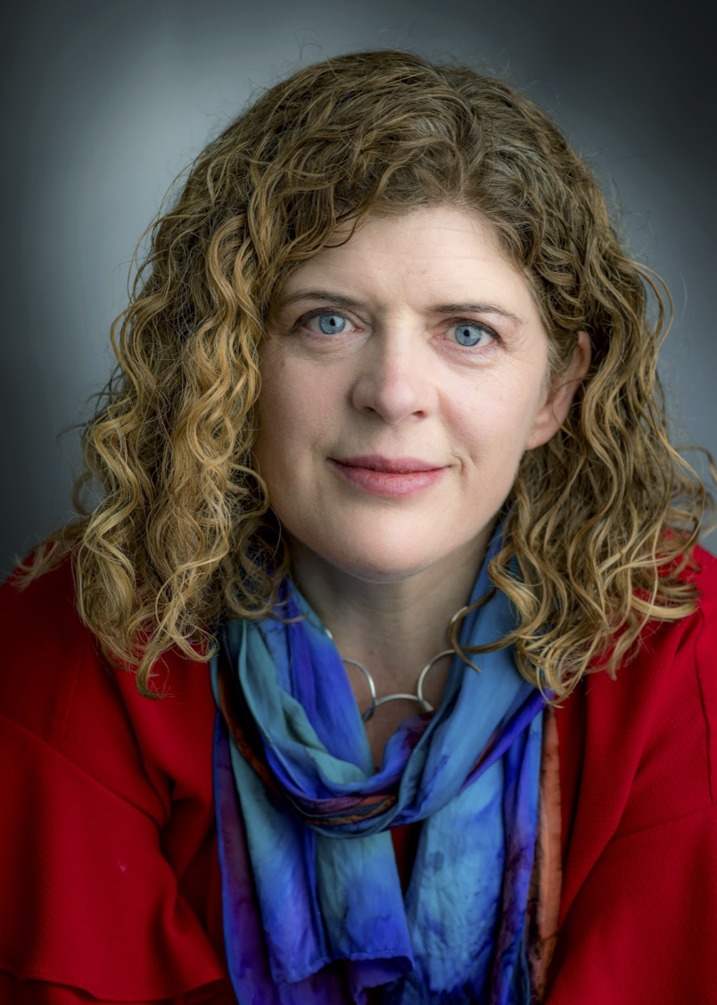
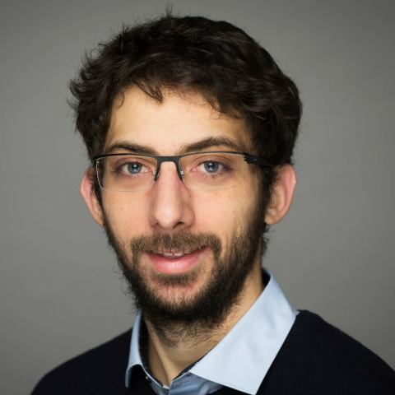




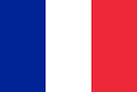

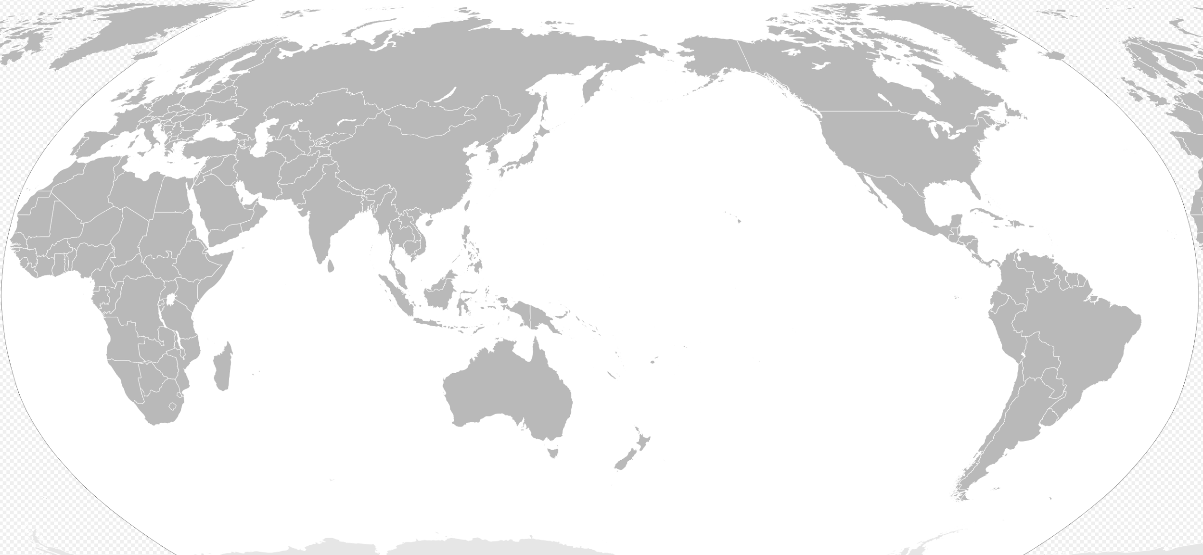
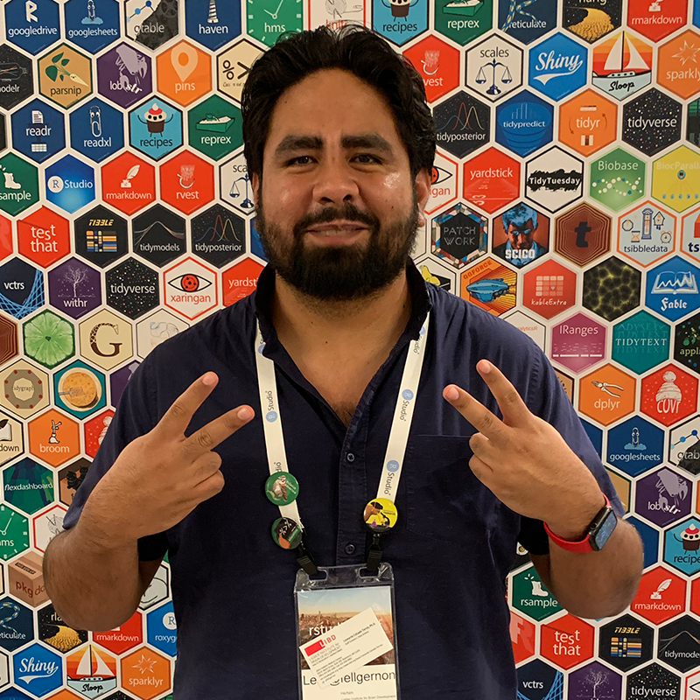
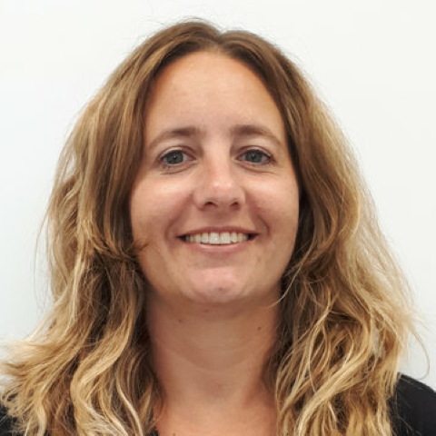

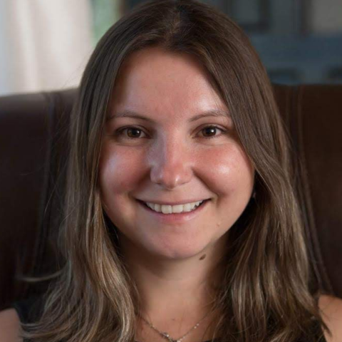


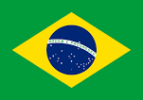
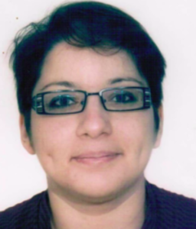
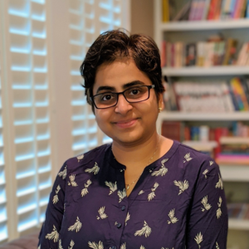

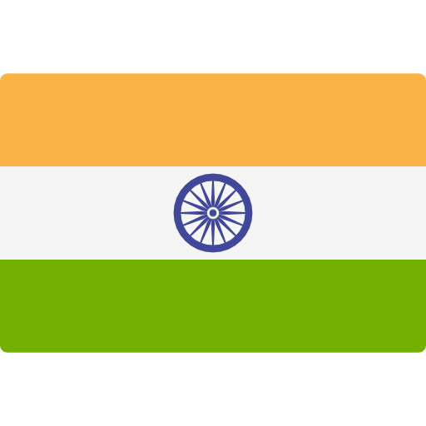
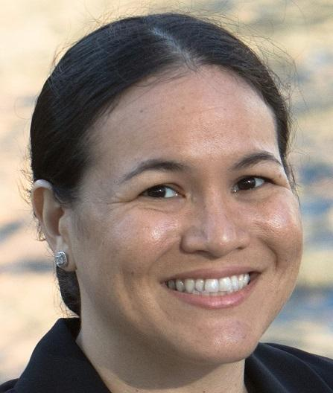
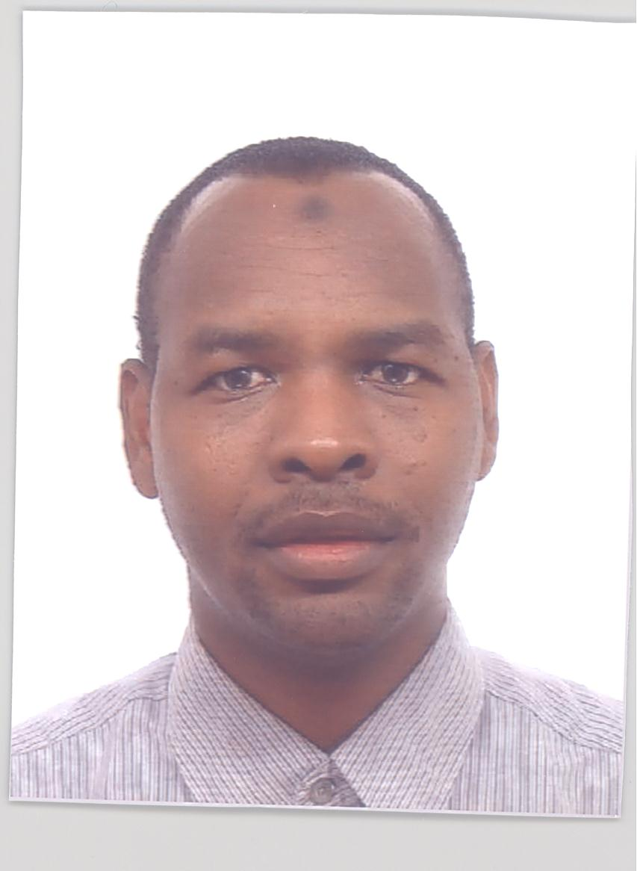
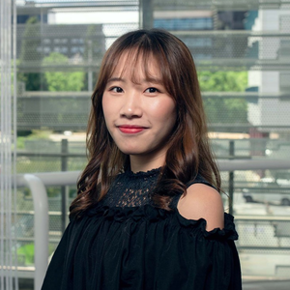

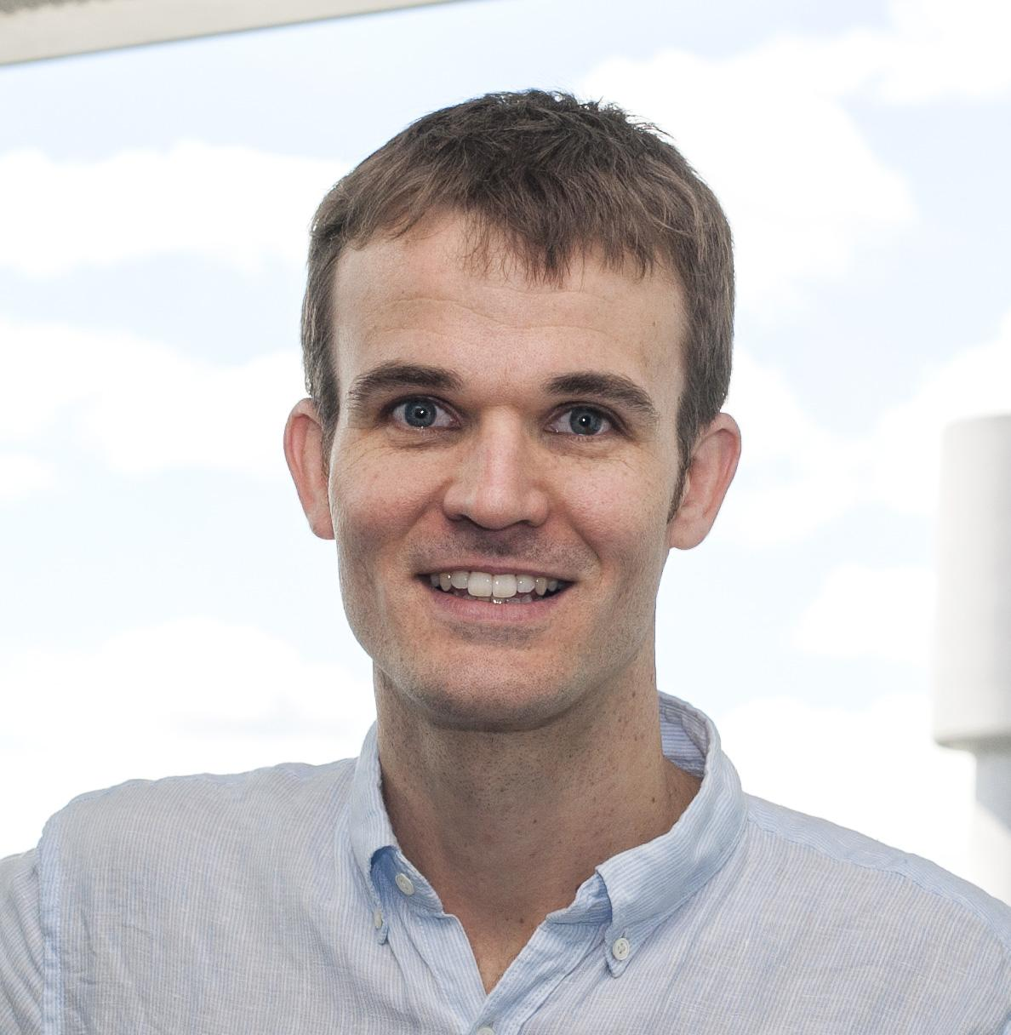
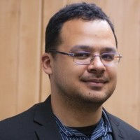
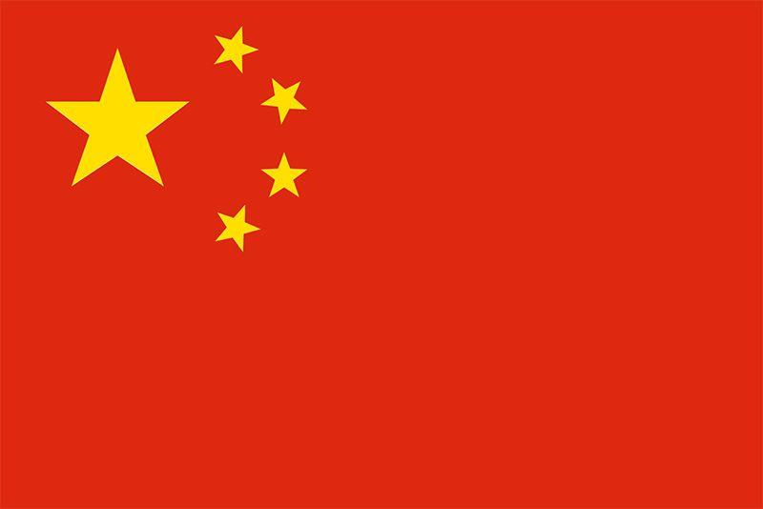

Bioconductor Community Advisory Board Members (2022)
Johannes Rainer
Eurac Research, Italy
Kozo Nishida
TUAT, Japan
Susan Holmes Stanford, USA
Lori Shepherd
Roswell Park Comprehensive Cancer Center, USA
Aedin Culhane, Limerick, Ireland
Kevin Rue-Albrecht
University of Oxford, UK
Mike Smith
EMBL, Germany
Leo Lahti
University Turku, Finland
Leonardo Collado-Torres
Lieber Institute for Brain Development, USA
Estefania Mancini Centre for Genomic Regulation, Spain
Daniela Cassol
Lawrence Berkeley
National Lab, USA
Hedia Tnani, CNAG, Spain.
Janani Ravi,
University of Colorado Anschutz Medical Campus, USA.
Nicole Ortogero
NanoString Technologies,
Seattle, USA
Xueyi Dong, WEHI, Australia
Matt Ritchie
WEHI, Australia
Benilton Carvalho
University of Campinas, Brazil
Yagoub A. I. Adam
Covenant University,
Nigeria
World map from https://commons.wikimedia.org/wiki/File:BlankMap-World-162E.svg
Notes:
There is a Community advisory board made up of members from all over the world that advise on how the project can support the global Bioconductor community.

Slide 7
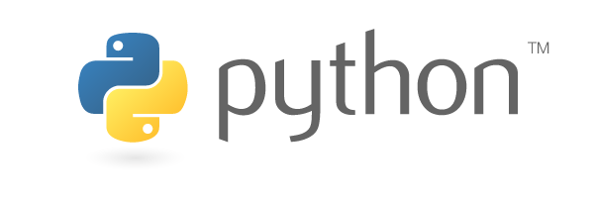
Bioconductor and Python
Several algorithms written in Python are accessible in Bioconductor and vice versa
Some Bioconductor interactive teaching material is available in Jupyter notebooks
Researchers are increasingly using both Bioconductor and Python in analyses
Bioconductor and Python have some common community interests e.g. increasing diversity and inclusion
Notes:
Bioconductor has growing connections with Python
Bioconductor packages like Basilisk allow us to leverage Python’s strengths in fields such as machine learning and image analysis.
Python can leverage Bioconductor’s strengths in statistical packages for biology data analysis
DEI projects
Bioconductor
https://chanzuckerberg.com/eoss/proposals/bioconductor-sustaining-a-worldwide-community-of-genome-data-scientists/
https://chanzuckerberg.com/eoss/proposals/bioconductor-high-quality-training-and-support-for-a-worldwide-community/
Python
https://chanzuckerberg.com/eoss/proposals/advancing-an-inclusive-culture-in-the-scientific-python-ecosystem/

Slide 8
Interested to learn more?
Chat to me at this meetup!
Follow @Bioconductor on Twitter
Join Bioconductor Community on Slack https://bioc-community.herokuapp.com/
These slides https://bit.ly/bioc-oct18

